Slide 1

Vision 2.0 Implementation planning
Campus Open Forums
March 21 & 22, 2018

Slide 2

Vision 2.0 Initiatives
Academic Programs of the Future
Cyberspace Master Plan
Re-emergence of UMA (UC Reintegration)
Civic Engagement Steering Committee (NVM)
Strategic Communications, Enrollment & Marketing Plans

Slide 3
uma.edu/vision

Slide 4
Academic Programs of the Future
Team Leads: Provost Joe Szakas,
Dean Brenda McAleer & Dean Greg Fahy
Request for Proposals to increase student engagement with faculty, with the curriculum and with the community across a variety of modalities.
5 proposals, 3 programs selected:
Education Pathways
Justice Studies
Information and Library Science

Slide 5
Cyberspace master plan
Team Lead: Sheri Fraser, Dean of Students
Development of a plan to support distance students through virtual pathways to services. The team will investigate best practices, conduct focus groups/surveys, and assess student services.
The Plan will focus on four key areas:
Navigation
Access
Service
Engagement
Plan due: April 13th

Slide 6
Re-emergence of UMA
Mission & Structure Team
Lead: President Wyke
Academic Support Team
Leads: Provost Szakas, Dean McAleer & Dean Fahy
Marketing & Communications Team
Leads: Jon Henry, VPEM & Domna Giatas, ED Planning/Communications
Preliminary recommendations due: March 16th
Final recommendations due: April 13th

Slide 7
Re-emergence of UMA: DRAFT Goals Mission & structure
To champion the re-emergence of UMA as a dispersed learning community, united by our mission and working in concert for the benefit of our students through our campuses, centers, and at a distance.
To expand UMA’s role as the leading provider of distance education programs to serve student needs across Maine and beyond.
To develop an omni-channel strategy that engages students through a seamless, high-quality, integrated educational experience.
To collaborate with other UMS institutions to support their distance education efforts though UMA’s dispersed services model.
To advance a unified structure that is inclusive of all roles and locations.
To support brand clarity for both internal and external audiences.

Slide 8
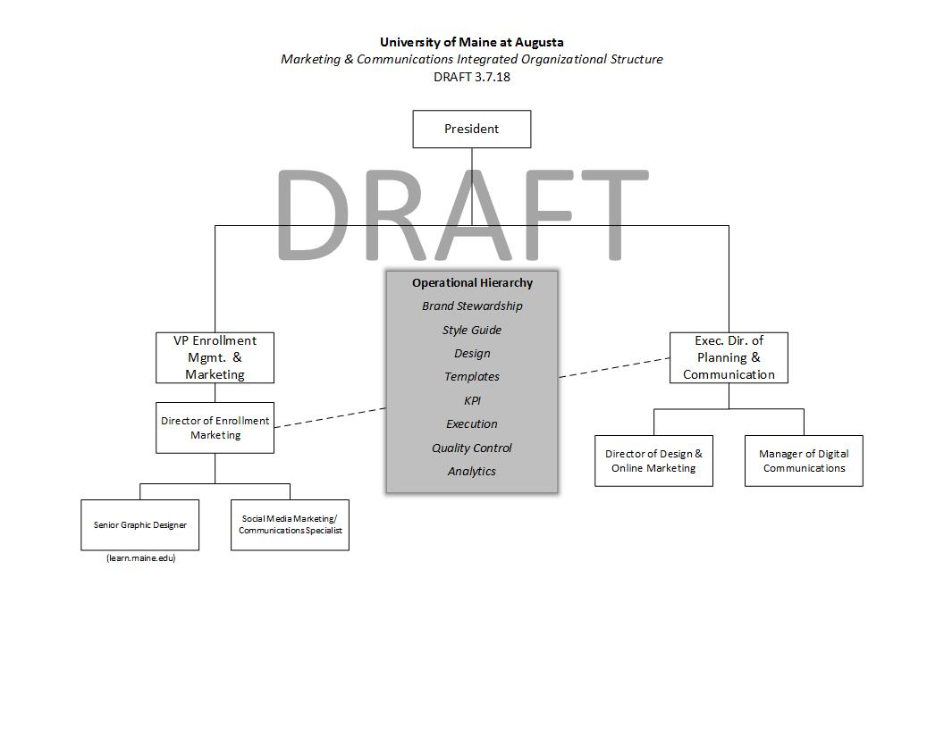
Re-emergence of UMA Marketing & Communications

Slide 9
Re-emergence of UMA Academic Support
Director/Dean
Library Services
Faculty Services
Academic Logistics
Learning Success
Centers
Provost
DRAFT

Slide 10
Civic Engagement Steering committee
Civic Engagement Steering Committee
Katie Corlew, Faculty Co-Chair &
Gilda Nardone, Administration Co-Chair
Create, coordinate, and communicate a Civic Engagement Continuum within the UMA community that will enhance the development of informed, responsible, and involved citizen-graduates.
Currently compiling a comprehensive inventory of current activities.
Plan due: April 13th

Slide 11
Strategic Communications, Enrollment & Marketing Plans
Strategic Communications Plan complete
Domna Giatas, ED Planning & Communications
Strategic Enrollment Plan complete
Jon Henry, VP Enrollment & Marketing
Enrollment Planning & Implementation Council (EPIC)
Strategic Marketing Plan Short-term plan complete
Long-term plan in development
Jon Henry, VP Enrollment & Marketing
Brent Wooten, Director of Enrollment Marketing

Slide 12
Thank you for joining this journey
2020
UMA.edu/Vision

