Slide 1
Vision 2.0 Wrap-up
Campus Open Forums
April 23 & 25, 2018

Slide 2
Today’s Agenda
Quick Review:
Academic Programs of the Future
Strategic Communications, Marketing & Enrollment Plans
Re-emergence of UMA: Final Plans
Academic Services Division
Communications & Marketing Teams
Civic Engagement Plan – survey available until April 27th
Cyberspace Master Plan – survey available until April 27th
Discussion

Slide 3
Academic Programs of the Future
Team Leads: Provost Joe Szakas,
Dean Brenda McAleer & Dean Greg Fahy
Request for Proposals to increase student engagement with faculty, with the curriculum and with the community across a variety of modalities.
5 proposals, 3 programs selected:
Education Pathways
Justice Studies
Information and Library Science

Slide 4
Strategic Communications, Enrollment & Marketing Plans
Strategic Communications Plan complete
Domna Giatas, ED Planning & Communications
Strategic Enrollment Plan complete
Jon Henry, VP Enrollment & Marketing
Enrollment Planning & Implementation Council (EPIC)
Strategic Marketing Plan Short-term plan complete
Long-term plan in development
Jon Henry, VP Enrollment & Marketing
Brent Wooten, Director of Enrollment Marketing

Slide 5
Re-emergence of UMA
Mission & Structure Team
Lead: President Wyke
Academic Support Team
Leads: Provost Szakas, Dean McAleer & Dean Fahy
Marketing & Communications Team
Leads: Jon Henry, VPEM & Domna Giatas, ED Planning/Communications
Preliminary recommendations due: March 16th
Final recommendations due: April 13th

Slide 6
Re-emergence of UMA: DRAFT Goals Mission & structure
To champion the re-emergence of UMA as a dispersed learning community, united by our mission and working in concert for the benefit of our students through our campuses, centers, and at a distance.
To expand UMA’s role as the leading provider of distance education programs to serve student needs across Maine and beyond.
To develop an omni-channel strategy that engages students through a seamless, high-quality, integrated educational experience.
To collaborate with other UMS institutions to support their distance education efforts though UMA’s dispersed services model.
To advance a unified structure that is inclusive of all roles and locations.
To support brand clarity for both internal and external audiences.

Slide 7
Re-emergence of UMA: Proposed Structural changes
Combines resources of UMA and University College into:
An Academic Services Division
- Original UC staff, plus Library Services & UMA Sr. Instructional Design Specialist;
UC Centers renamed as UMA Centers
A Marketing & Communications Team
- Original Marketing & Communications staff, plus UC Senior Graphic Designer
& Social Media, Marketing Communications Specialist
No new positions have been added
Chancellor and BOT support
Writing & Math Lab faculty continue to report to Academic Deans
Continued discussion re: some additional learning support services included at a future date
Implementation of final structure before end of current fiscal year

Slide 8
Re-emergence of UMA: Academic Services Division
Academic Services Division
Learning and Student Support
UMS/UMA
IT Services
Dean of
Academic
Services
Academic Deans
Dean of
Students
Instructional Services
Library Services
UMA Centers
Director of
Instructional
Services
Director of
Library
Services
Director of
Centers
Academic
Logistics
rev 041918

Slide 9
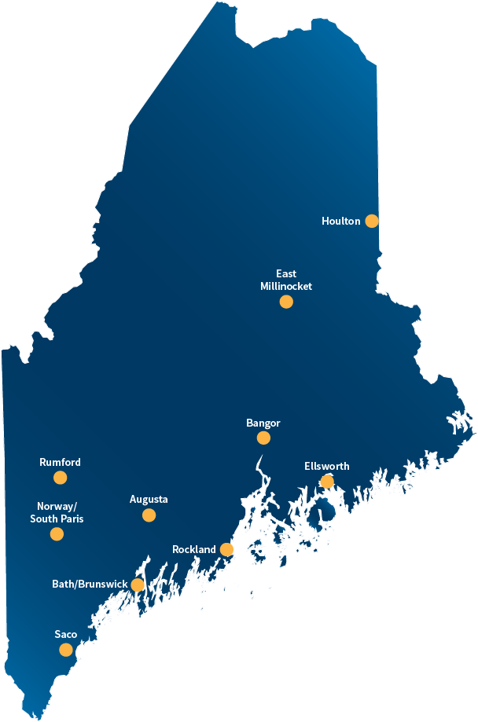
UMA Centers
UMA Brunswick Center
UMA East Millinocket Center
UMA Ellsworth Center
UMA Houlton Center
UMA South Paris Center
UMA Rockland Center
UMA Rumford Center
UMA Saco Center

Slide 10
Re-emergence of UMA: Marketing & Communications

Slide 11
Civic Engagement Plan
Kati Corlew, Faculty Co-Chair
Gilda Nardone, Administrative Co-Chair

Slide 12
Civic Engagement – Overall Goal
Create, coordinate, and communicate a continuum of Civic Engagement activities within the UMA community, as outlined in the University’s strategic plan (Strategy 3.5), that will enhance the development of informed, responsible, and involved citizen-graduates.

Slide 13
Civic Engagement – Working Definition
“Civic engagement means working to make a difference in the civic life of our communities and developing the combination of knowledge, skills, values, and motivation to make that difference. It means promoting the quality of life in a community, though both political and non-political processes.”
- Thomas Ehrlich, Civic Responsibility and Higher Education, 2000

Slide 14
Civic Engagement – Guiding Principles
Student-Focused
Statewide
Valuing all Contributions
Building Capacity and a Community of Practice

Slide 15
Civic Engagement – Short-Term Plan (Feb-Aug 2018)
Establish an inclusive Civic Engagement (CE) Steering Committee
Establish regular communication and coordination between faculty and administration Co-Chairs
Inventory and communicate existing interest, activity, capacity, and resources
Develop systems for sharing CE information and resources within the Steering Committee

Slide 16
Civic Engagement – Short-Term Plan (Feb-Aug 2018)
Research other CE models and resources
Set priority goals and clarify process
Explore badging
Develop internship models
Integrate into Academic Programs of the Future, as appropriate
Develop proposal for a CE course designator
Coordinate calendar and communication

Slide 17
Civic Engagement – Longer-Term Plan (Sept 2018-June 2019)
Assess progress on priority goals
Define an organizational structure for CE at UMA
Clarify leadership roles
Explore options for virtual resource hub
Communicate about CE to the broader community
Build capacity and develop resources
Develop and begin to implement CE Professional Development Plan

Slide 18
Civic Engagement – Maine Campus Compact Awards
Donald Harwood Faculty Award for Service-Learning Excellence
Sharon McMahon Sawyer
Heart and Soul Student Award
Aaminah Aleem
President’s Campus Leadership Award
First Nations Student Circle
“PILLARS” Philanthropy Innovation Learning Leadership Action Responsibility Service Certificate
Cathy Geren
Award ceremony is being held at Bates College on 4/25 from 2-4pm

Slide 19
Cyberspace master plan
Sheri Fraser, Dean of Students

Slide 20
Cyberspace Master Plan - Vision 2.0 Call to Action
Develop a “Cyberspace” Master Plan to provide all students with digital pathways to services & support.

Slide 21
Cyberspace Master Plan – What our students want
Improved navigation
One stop view (dashboard)
Mobile access
Task reminders
One stop service
Clear contact person(s)/advisor
Community of online learners
Live chat/help options
Consistent class experience

Slide 22
Cyberspace Master Plan – Goals for Cyberspace environment
Easily access information
Communicate with faculty and staff
Conduct transactions with device(s) of choice
Create sense of belonging
Promote student engagement

Slide 23
UMA Cyberspace
Navigation
Access
Service
Engagement

Slide 24
Cyberspace Master Plan – Navigation
Establish portal as front door for digital services & support
Adopt task-based navigation for the portal and web
Integrate and unify technology

Slide 25
Cyberspace Master Plan – Access
Invest in mobile access
Create a UMA APP(s)
Partnerships to provide mobile devices

Slide 26
Cyberspace Master Plan – Service
Introduce on-demand concierge service
Pilot dynamic Q & A tool
Improve customer service (hand-offs and response times)
Expand embedded services & information in classes
Improve registration information & procedures
Explore navigator/coach model

Slide 27
Cyberspace Master Plan – Engagement
Build online engagement activities
Create specific space(s) for online engagement
Gamify and incentivize participation
Establish online clubs/student organizations
Provide community with tools, such as Adobe Creative Cloud and “Maker Spaces”
Regional location engagement
Increase asynchronous and hybrid option

Slide 28
Cyberspace Master Plan – Next Steps
Implementation Oversight Group
Continuous Improvement/Evolution

Slide 29
Cyberspace Master Plan – Appreciation & Gratitude: Committee members
Sherri Brann
Haley Brown
Chip Curry
Matthew Dube
Lauren Dubois
Brandy Finck
Sheri Fraser
Justin Hafford
Pierre Laot
Tom Nickerson
Jodi Williams

Slide 30
uma.edu/vision
Wrap Up Letter to Campus April 30th

Slide 31
Thank you for joining this journey
2020
UMA.edu/Vision

