Slide 1
2019 Great Colleges Survey
Overview

Slide 2
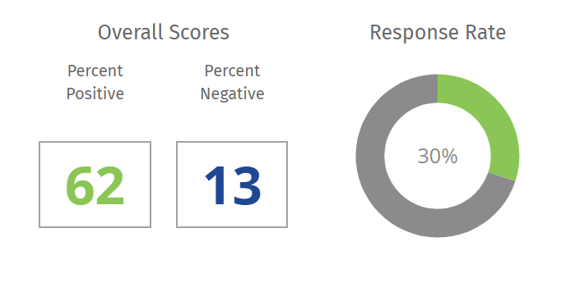
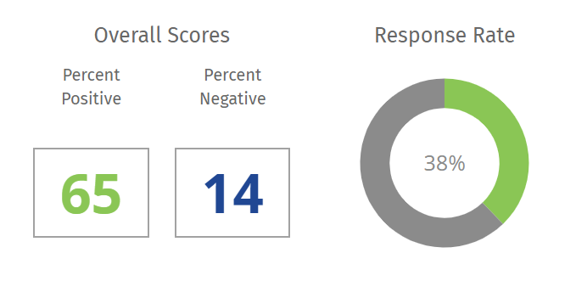
Survey Overview—participation increased
2016
2019

Slide 3
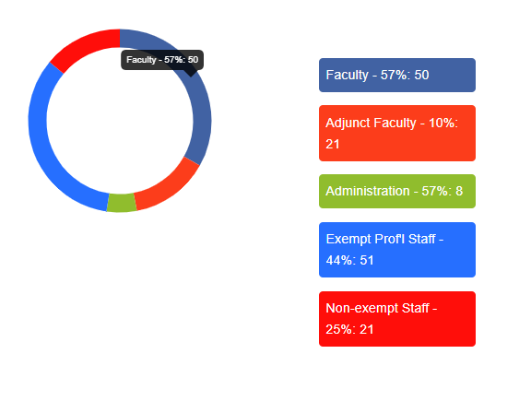
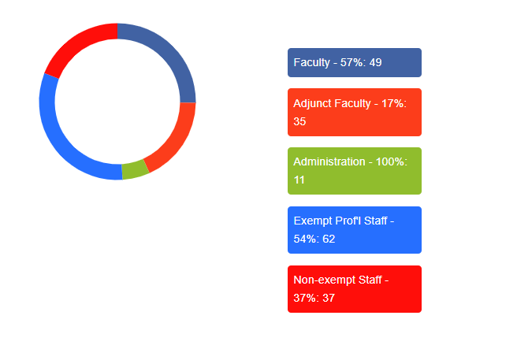
Participation by employee group
2016
2019

Slide 4
15 Core Survey Dimensions
Job satisfaction/support | Compensation, benefits and work/life balance | Shared governance
Senior leadership | Collaboration | Teaching environment
Facilities | Pride | Faculty, administration and staff relations
Fairness | Professional development | Policies, resources and efficiency
Supervisors/department chairs | Communication | Respect and appreciation

Slide 5
Response Guidelines
If positive response…. | and negative response… | then considered:
75%+ | <10% | Exceptional, very good
64-74% | 10-14% | Fair, good
55-64% | 15-19% | Yellow flag
45-54% | 20-29% | Red flag
<45% | 30%+ | Acute

Slide 6
Our Top Strength Dimensions
Pride
Job Satisfaction & Support
Facilities
Supervisors
Senior Leadership
Faculty, Admin and Staff Relations
Exceptional,
Very Good
Fair, Good

Slide 7
Our Top 10 Strength Statements
I understand how my job contributes to this institution's mission.
I have a good relationship with my supervisor/department chair.
At this institution, people are supportive of their colleagues regardless of their heritage or background.
I am given the responsibility and freedom to do my job.
This institution actively contributes to the community.
Overall, my department is a good place to work.
My supervisor/department chair is consistent and fair.
My supervisor/department chair regularly models this institution's values.
This institution's policies and practices give me the flexibility to manage my work and personal life.
My supervisor/department chair supports my efforts to balance my work and personal life.

Slide 8
Where did we see improvement?
Dimension | 2016 overall positive % | 2019 overall positive % | Improvement %
Senior leadership | 54 | 66 | 12
Shared governance | 54 | 62 | 8
Faculty, admin and staff relations | 58 | 65 | 7
Facilities | 64 | 70 | 6
Policies, resources and efficiency | 51 | 55 | 4
Respect and appreciation | 59 | 63 | 4
Professional Development | 66 | 69 | 3
Communication | 57 | 60 | 3
Fairness | 57 | 60 | 3
Compensation, benefits and work/life balance | 70 | 71 | 1

Slide 9
Our Top 10 Opportunities
My department has adequate faculty/staff to achieve our goals.
Our orientation program prepares new faculty, administration and staff to be effective.
I am paid fairly for my work.
Issues of low performance are addressed in my department.
There's a sense that we're all on the same team at this institution.
Our recognition and awards programs are meaningful to me.
Senior leadership provides a clear direction for this institution's future.
I am regularly recognized for my contributions.
Promotions in my department are based on a person's ability.
There is regular and open communication among faculty, administration and staff.

