Slide 1

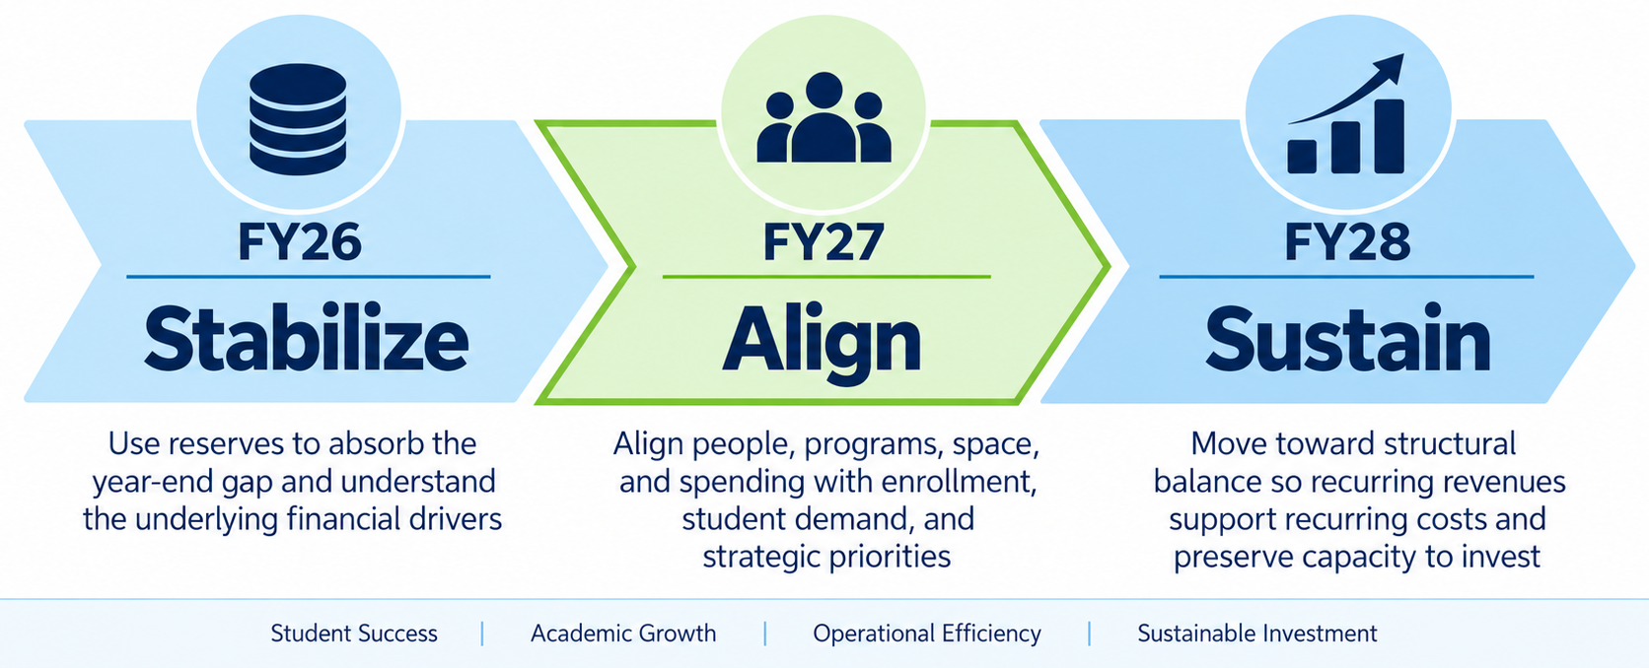
Strategy #6: Aligning Resources with UMA’s Future
Building a balanced, sustainable financial model that supports our strategic priorities.
Notes:
Good afternoon, everyone.
What I want to do over the next few minutes is talk about where we are financially, but more importantly, how we move forward.
And I want to frame this directly through UMA's Strategic Plan — particularly Strategy 6: Strive for Efficiency and Sustainability.
That strategy asks us to do something broader than simply balance a budget. It asks us to make sure that our human, financial, and other resources are sufficient to sustain the quality of our educational programs and support our mission, while becoming more efficient and building long-term financial resilience.
So I think about the next three years in three stages: stabilize, align, and sustain.
FY26 has really been about stabilizing. As we move through FY27, our work increasingly becomes one of aligning our resources with our priorities and with student demand. And by FY28, our goal is to have a sustainable operating model in which recurring revenues are supporting recurring expenses.
So that's the framework I want to use for the rest of this conversation.

Slide 2
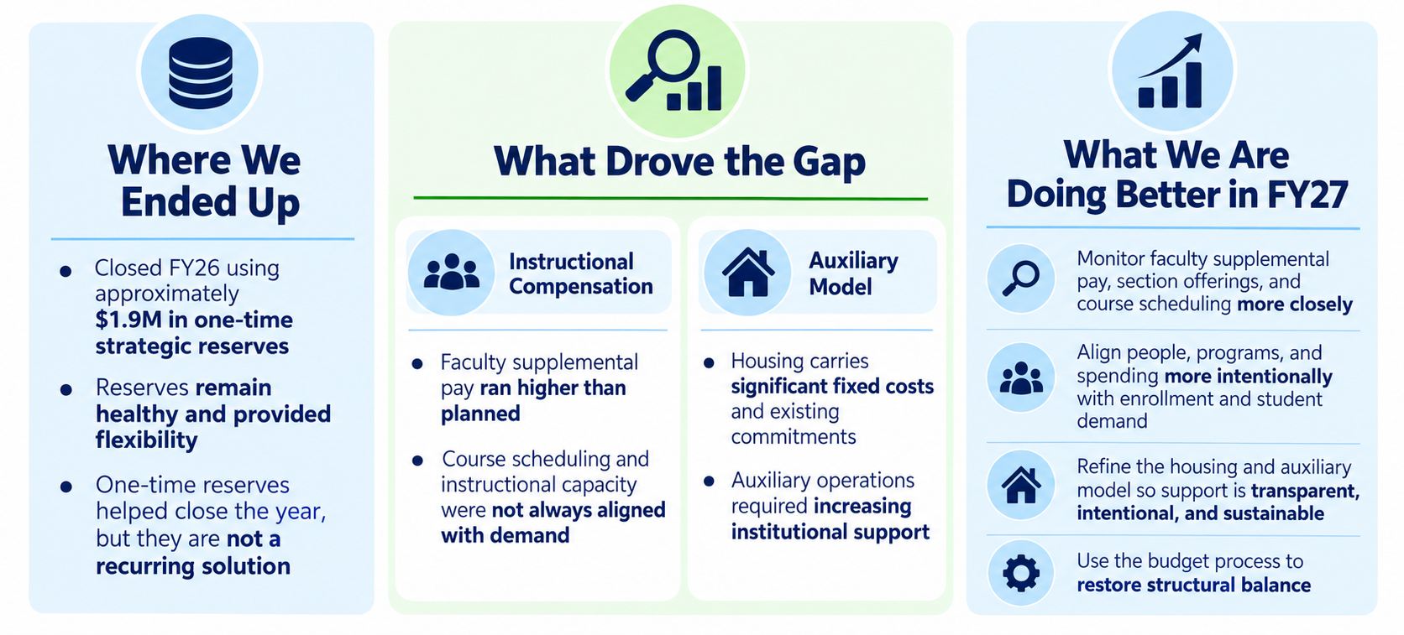
FY26: Where We Started and What We Learned
FY26 revealed structural pressures; FY27 is about sustainable alignment and better controls.
Notes:
To understand where we're going, we first need to be clear about where we're starting.
For FY26, UMA used approximately $1.9 million in one-time strategic reserves to support the operating budget.
The important context is that UMA's reserves remain healthy. Using reserves strategically is not inherently a problem. In fact, one of the reasons institutions maintain reserves is to give themselves time to respond thoughtfully when circumstances change.
But reserves are a bridge, not a recurring revenue source.
And that's where this connects directly to Strategy 6, which calls for disciplined fiscal stewardship, strategic investment in mission-critical priorities, and long-term financial resilience.
So our issue isn't simply that we used reserves in FY26. Our issue is making sure that we don't build a financial model that depends upon using them year after year to support recurring operations.
And as we've looked more closely at the FY26 budget, two areas have been particularly important.
The first is instructional compensation, including supplemental teaching costs, where spending and student demand have not always been as closely aligned as they need to be.
The second is our auxiliary model, particularly housing, where we carry significant fixed costs regardless of how many students occupy those beds.
Neither of those issues has a single quick solution.
That's why I think of this as a progression. We stabilized in FY26, we increasingly align revenues and expenses in FY27, and our objective is to reach a more structurally sustainable position in FY28.

Slide 3
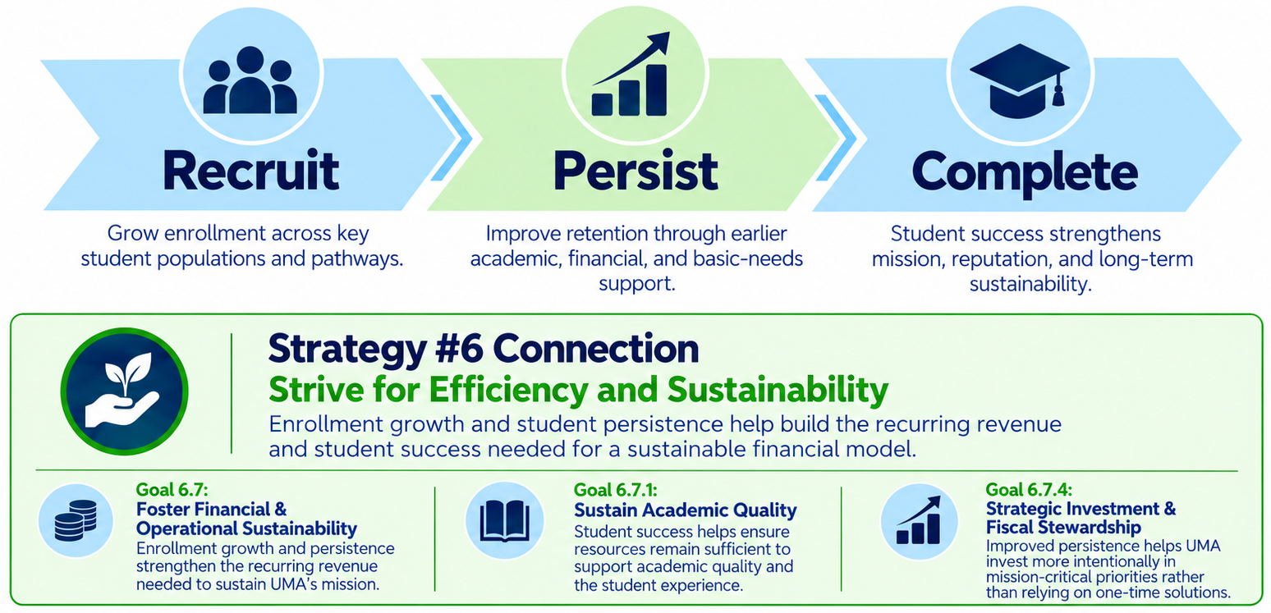
Enrollment and Persistence Drive Sustainability
Recruitment, retention, and student success strengthen both mission and margin.
Notes:
One of the most important things to recognize is that financial sustainability isn't simply a cost-cutting exercise.
Growth matters.
For UMA, that means recruiting students across the many populations we serve — on our campuses, through our centers, online, through Early College, through workforce pathways, and through other flexible models of education.
But recruitment by itself isn't enough.
We also have to help students persist and ultimately complete their education.
Every student we retain represents someone continuing toward a degree or credential, and that is first and foremost a student-success outcome. But there is also a very real financial relationship here: stronger persistence creates a stronger and more predictable recurring revenue base.
That's why investments in advising, academic support, financial wellness, basic-needs support, engagement, and earlier intervention matter so much. Please note that Strategy 6 in our strategic plan isn’t about austerity, it is about the balance between responsive student support and responsible fiscal management.
And this connects directly with work already underway at our university, including the Food Insecurity Task Force or the upcoming Financial Wellness and Basic Needs initiative.
So when we talk about budget sustainability, I don't want us to think only about the expense side of the ledger.
The equation is really both sides: grow enrollment, improve persistence, support completion, and manage our resources responsibly.

Slide 4
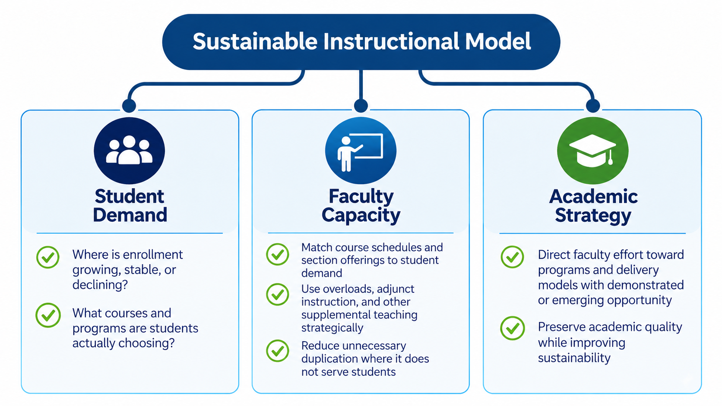
Aligning Faculty Effort With Student Demand
Putting instructional capacity where it has the greatest impact.
Notes:
This is an especially important part of the conversation because instructional resources represent both the heart of our academic mission and one of our largest institutional investments.
The objective here is alignment — not simply reduction.
We need to better understand where student demand is growing, where it is stable, and where it may be changing.
Then we need to ask whether our course schedules, section offerings, faculty capacity, adjunct instruction, and supplemental teaching are aligned with that demand.
There will always be important academic considerations beyond enrollment numbers alone. Programs have curricular and accreditation requirements. Students need courses in sequence. Academic quality matters. And we have obligations to provide a comprehensive educational experience.
So this cannot simply become an exercise in looking at a spreadsheet and eliminating low-enrolled courses.
But at the same time, we need to be willing to examine patterns.
Strategy 6 does ask us to ensure that our human and financial resources are sufficient to sustain the quality of the educational program and support the mission.
If we routinely offer more instructional capacity than students need in one area while struggling to provide enough capacity in another, we should be asking whether resources can be deployed differently.
That is particularly important as we identify programs and delivery models with opportunities for growth.
The goal is really the phrase at the top center of this slide: a sustainable instructional model.
And to me that means putting our faculty talent and instructional resources where they can have the greatest impact on students while preserving academic quality.

Slide 5
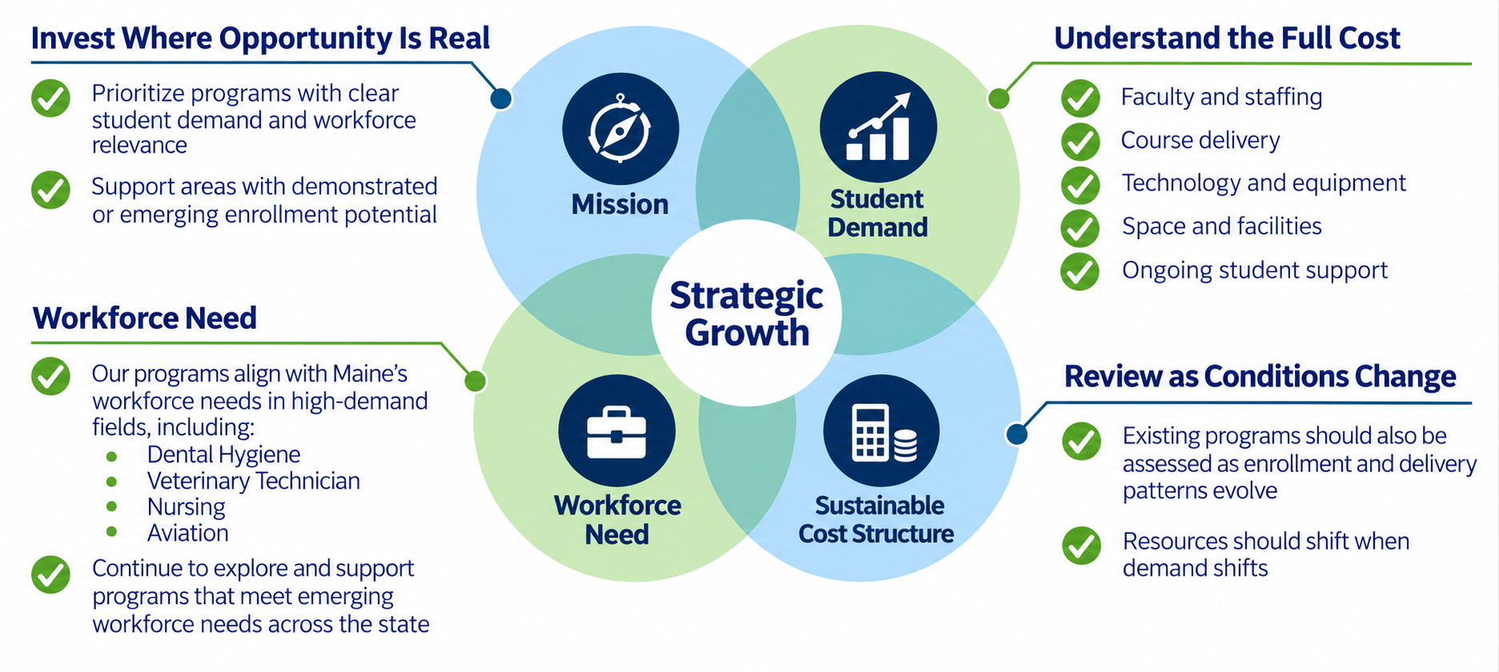
Growing Strategically, Not Simply Adding
New and existing programs need both mission value and a sustainable operating model.
Notes:
That brings us naturally to growth.
I absolutely believe UMA has opportunities to grow. But growth and simply adding things are not necessarily the same thing.
As we consider new programs — or investments in existing programs — I think we need to ask four questions.
Does this advance our mission?
Is there demonstrated or emerging student demand?
Does it respond to a workforce or community need?
And can we support it with a sustainable cost structure?
The strongest opportunities are where those things intersect.
Strategy 6 specifically calls for strategic investment in mission-critical priorities. That's exactly how I think we should approach growth.
We already have examples of areas with significant workforce relevance — including health professions, veterinary technology, nursing, aviation, and other programs connected with Maine's workforce needs.
But the discipline we need going forward is to understand the complete operating model before making long-term commitments.
What will enrollment reasonably look like? What faculty and staff capacity is required? What specialized facilities or equipment are needed? And what enrollment level allows the program to remain sustainable?
That's not intended to discourage innovation.
It's actually what allows us to invest confidently in innovation, because we're making those investments with a clearer understanding of what it will take for them to succeed.

Slide 6
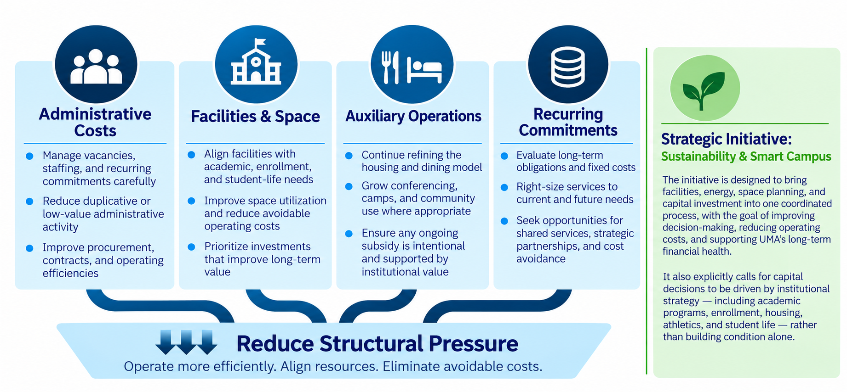
Managing the Broader Cost Structure
Protecting academic priorities by reducing structural pressure elsewhere.
Notes:
Instruction and enrollment are major pieces of the equation, but they aren't the whole equation.
We also need to look across the broader cost structure of the university and ask how we can operate more intentionally.
One area is our physical footprint.
Strategy 6 specifically calls for data-driven space planning, greater use of flexible and multi-purpose spaces, better scheduling and shared use, and integrating that information into capital planning and deferred-maintenance decisions.
UMA has already reduced significant amounts of space over the past several years, and we're continuing to think strategically about what space we actually need, how effectively we're using it, and where buildings or spaces can serve multiple purposes.
Another area is our auxiliary operations.
Housing is probably the clearest example. We need a model that better aligns capacity, occupancy, pricing, and the fixed costs associated with providing residential services.
And more broadly, we need to continue examining administrative and operational costs so that as much of our institutional capacity as possible can support our academic mission and our students.
Strategy 6 also addresses energy efficiency — not simply as an environmental objective, but as a financial one. It explicitly calls for using efficiency improvements to reduce operating costs, preserve facilities, and protect the university's net asset value.
This connects directly to the Sustainability and Smart Campus work in our strategic plan, which will also integrate perfectly with a comprehensive master-planning refresh.
I do not envision empty campuses and centers with lower costs. I want us to plan for engaging, welcoming campuses and centers, collaborative spaces, wellness, housing, and better use of our facilities.
The objective isn't simply to spend less.
It is to use our assets more intentionally, create stronger campus and center environments, and reduce structural financial pressure so that we preserve resources for the mission.

Slide 7
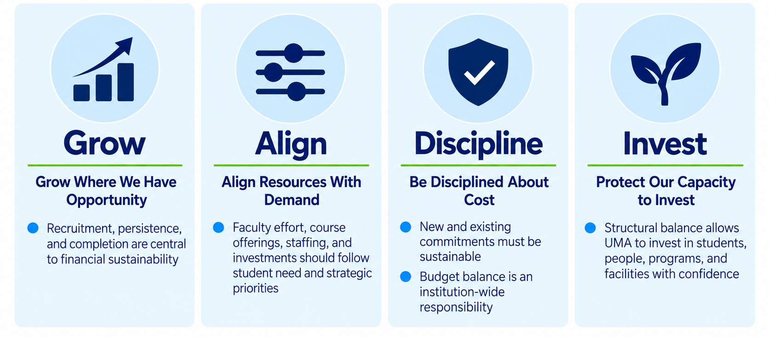
What This Means for All of Us
Balancing the budget requires shared focus, thoughtful choices, and alignment with UMA’s future.
Notes:
So when we step back and look at the whole picture, I think it comes down to four things: grow, align, be disciplined, and invest.
First, we need to grow where we have opportunity.
Recruitment matters. Persistence matters. Completion matters. Those are student-success priorities, but they're also fundamental to building the recurring revenue base that supports everything else we do.
Second, we need to align resources with demand.
That applies to faculty effort and course offerings, but it also applies to staffing, space, facilities, and institutional investments. Increasingly, our resources need to follow student needs and the strategic direction of the university.
Third, we need to be disciplined about cost.
New commitments need to be sustainable, and existing commitments need to be reviewed as circumstances change. Budget balance can't be the responsibility of one program, one division, or one office. It is an institution-wide responsibility.
And finally — and I think this may be the most important point — we need to protect our capacity to invest.
The purpose of achieving financial sustainability isn't simply to arrive at zero at the bottom of a spreadsheet.
It is to give UMA the ability to make choices.
It means having the capacity to invest in programs that are growing, support students when they need help, maintain our facilities, respond to workforce opportunities, support our employees, and make strategic investments in the future rather than simply reacting to the financial pressures of the present.
That's where I think Strategy 6 of our strategic plan is particularly important. Financial and operational sustainability aren't separate from our academic mission. They are what allow us to continue investing in that mission.
And this work can't happen exclusively within Finance and Administration.
Over the coming months, as we build the FY28 budget, I want this to be a more collaborative campus conversation — involving academic leadership, faculty, staff, departments, and our existing shared governance and planning processes.
There will undoubtedly be difficult choices along the way.
But if we stay focused on these four principles — grow where we have opportunity, align our resources with demand, be disciplined about cost, and protect our capacity to invest — I think we have a very strong framework for making those choices together.
And ultimately, that's the goal: not simply balancing one year's budget, but building a sustainable UMA that has the capacity to invest in its students, its people, and its future.
So with that, I’ll turn it over to Provost Szakas, who will talk more about how we are advancing our academic strategy and translating that capacity into programs, teaching, and opportunities for our students.

