Slide 1

PRESIDENT'S TOWN HALL
Academics at UMA
Student Success, Innovation & the Future of Learning
Joseph Szakas, Provost and Vice President of Academic Affairs
October 1, 2026 | 12:00–12:45 p.m.

Slide 2
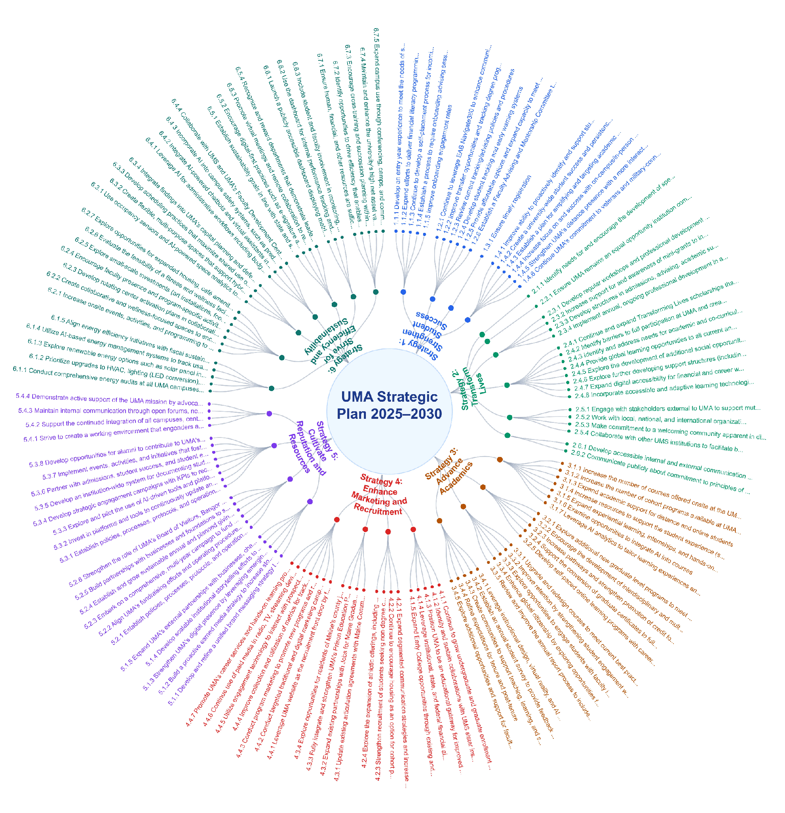
2025-2030 UMA Strategic Plan
KEY STRATEGIES
1
Strategy 1
Strengthen Student Success
2
Strategy 2
Transform Lives
3
Strategy 3
Advance Academics
4
Strategy 4
Enhance Marketing
and Recruitment
5
Strategy 5
Cultivate Reputation
and Resources
135 Action items
6
Strategy 6
Strive for Efficiency and Sustainability

Slide 3
NECHE-aligned goals guiding our academic priorities through 2030
29% → 35%
Graduation Rate
150% rate, first-time bachelor's
64% → 70%
First-Year Retention
IPEDS first-time, full-time
59% → 68%
SAM Total Success
Student Achievement Measure
53% → 55%
Part-Time Retention
Fall-to-fall, part-time students
Proven Retention Strategies
Housing (157 residence students)
Athletics (NCAA efforts, 13 sports teams)
Advising (3,900 meetings)
Early and Midterm Alerts (646 reports
submitted to the CARE team)
Early College (NACEP)
Student Success Goals (NISS)
Entry-Year Experience
Advising
Academic Design (DWF Rates-scheduling)
Financial Wellness
Enrollment Goals
Summer 2026 = 8,687 (9,568 census)
Fall 2026 = 34,089 (33,048 projected)
Spring 2027 = 28,581
Total Credit Hour Goal = 71,357
Charge to Academic Program Coordinators:
Each academic program will report on departmental student success outcomes and alignment with UMA’s Strategic Plan and key initiatives. Programs will identify resources needed to strengthen alignment, articulate their strengths and future direction of the program. Final reports are due to the Academic Deans by the end of March 2027.

Slide 4
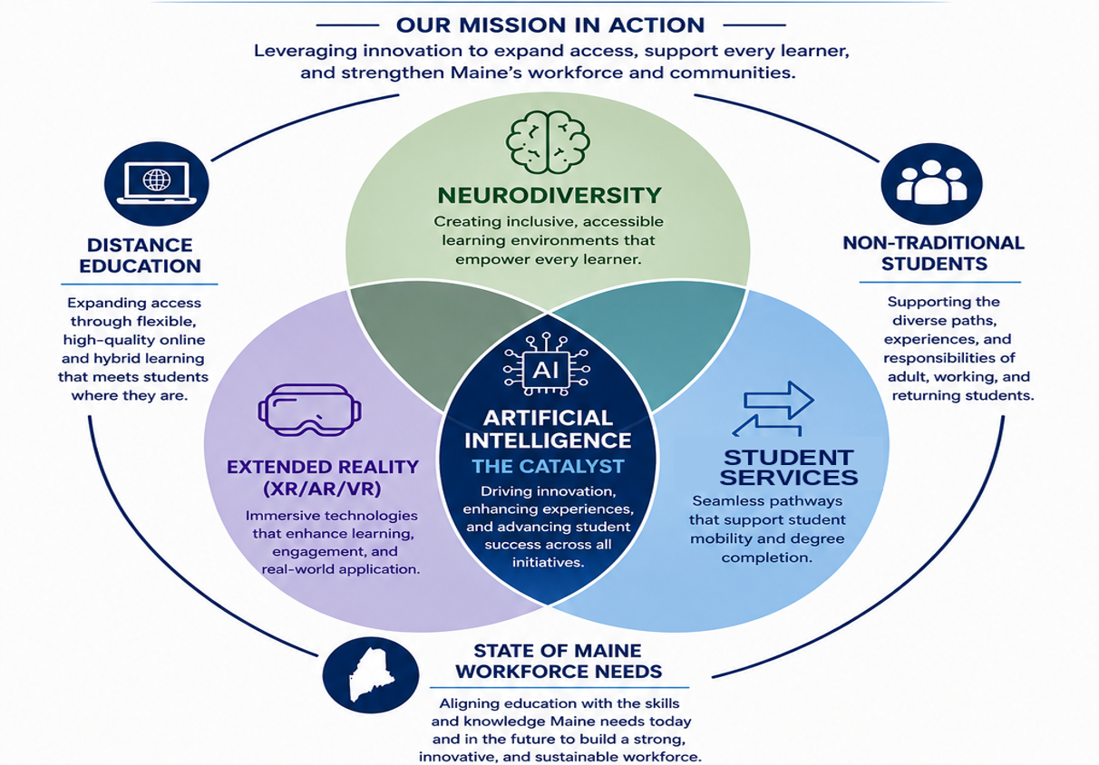

UMA’s Strategic Mission

Slide 5

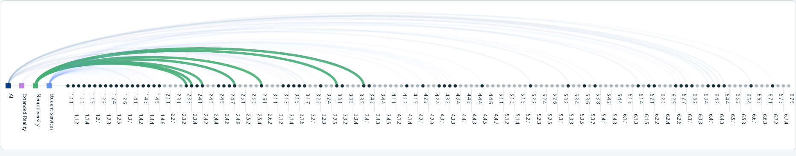
Steps UMA Has Taken
UMA INNOVATION INITIATIVE
Landmark College Conference participation
Staff professional development on neurodiversity
Faculty Community of Practice cohorts
Neurodiversity
PEP Neurodiversity survey and grant funding
Strategic Plan Alignment
Creating inclusive, accessible learning environments that empower every learner.

Slide 6

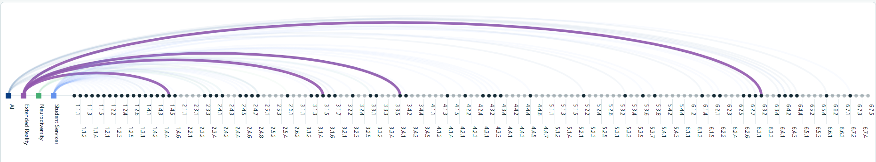
Steps UMA Has Taken
UMA INNOVATION INITIATIVE
Gaussian Splat and Matterport capture efforts
Nursing immersion-room simulations
Student projects in Unity, VR/AR, and computer gaming
Aviation VR simulation and AI debrief documentation
Extended Reality
(XR / AR / VR)
Davis AI/VR Grant VR Integration
Strategic Plan Alignment
Immersive technologies that enhance learning, engagement, and real-world application.

Slide 7

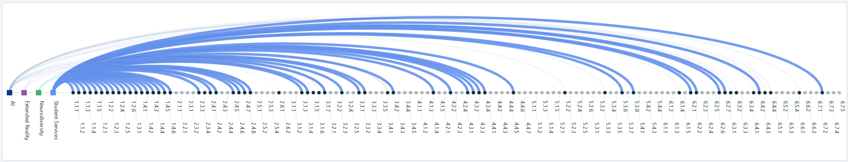
Steps UMA Has Taken
UMA INNOVATION INITIATIVE
EdSights AI chatbot and early-alert analytics
EAB Navigate360 advising and tracking platform
Student Services
Transfer evaluation process improvements
Strategic Plan Alignment
Seamless pathways that support student mobility and degree completion.

Slide 8

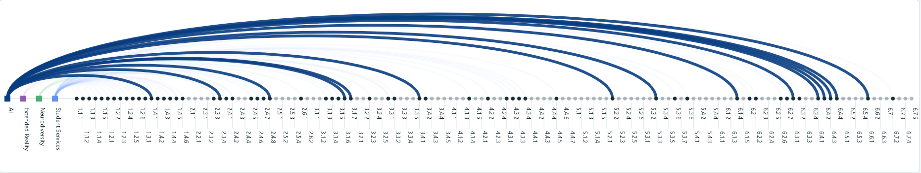
Steps UMA Has Taken
UMA INNOVATION INITIATIVE
Davis AI/VR Grant - Faculty Fellows program
AI GitHub Evaluator / Respondus / proctoring tools
Collage AI pilot
Artificial Intelligence
The Catalyst
Gates – Programs of the Future grant proposal
Grammarly pilot
BS-AI / BS-Applied AI ITP (with UM & USM)
Strategic Plan Alignment
Driving innovation, enhancing experiences, and advancing student success across all initiatives.

Slide 9
Davis AI VR Grant - Faculty Fellows
Landmark College Conference
Collage AI pilot
Faculty Community of Practice cohorts
Grammarly pilot
Staff Professional Development
AI GitHub Evaluator / Respondus / Proctoring
Gates - Programs of the Future Grant proposal
PEP Neurodiversity survey / grants
BS-AI / BS-Applied AI ITP (with UM & USM)
EdSights
EAB Navigate360
Gaussian Splat, Matterport efforts
Nursing Immersion room simulations
Transfer evaluation
Student Projects: Unity, VR-AR computer gaming
Aviation: VR simulation AI debrief documentation
Davis AI/VR Grant - VR Integration

